Slide 1

G2M insight for Cab Investment firm
Himani Aryan

Slide 2
Outline of the project
XYZ, an established private firm operating in the United States, has witnessed the remarkable growth and potential within the Cab Industry.
With the intention of capitalizing on this opportunity, the company is strategically planning to make a significant investment in the Cab Industry.
However, before finalizing their decision, XYZ adheres to a comprehensive Go-to-Market (G2M) strategy, which emphasizes understanding the market dynamics, intricacies, and potential challenges.
By conducting a thorough market analysis, XYZ aims to gather crucial insights and data to inform their investment decisions, ensuring a well-informed and strategic approach to maximize their chances of success in the Cab Industry.

Slide 3
Problem Statement
To assist XYZ firm in their quest to identify the ideal company for investment within the Cab Industry, we will leverage our expertise in analyzing the extensive data available.
Our dedicated team will meticulously scrutinize the provided information, employing advanced data analytics techniques to extract valuable insights and trends.
By conducting a comprehensive evaluation of the market landscape, competitor analysis, and financial performance, we will generate a detailed report highlighting the potential investment opportunities and risks associated with each company.
This comprehensive analysis will serve as a foundation for XYZ firm to make well-informed investment decisions, ensuring that they align their resources with a company that exhibits strong growth potential, financial stability, and strategic fit.

Slide 4
Approach
Conducting data exploration to examine the received data, including its features, number of columns, and column types.
Performing necessary transformations on columns, if needed, to ensure the data is appropriately structured for analysis.
Identifying and addressing any missing values present in the data to maintain data integrity.
Conducting univariate analysis to examine the relationship between individual numerical columns and the dependent variable, Profit.
Analysing categorical columns in relation to Profit to uncover any potential insights or patterns.
Conducting multivariate analysis to examine the relationships and interactions between multiple variables.
Scaling the columns, if required, to ensure comparability and accurate analysis.
Analysing the obtained graphs and visualizations to extract valuable insights and draw meaningful conclusions.

Slide 5
Data Exploration
Four files are utilized for analysis:
Cab_Data.csv: Contains transaction details for two cab companies.
Customer_ID.csv: A mapping table with a unique identifier that links customer demographic details.
Transaction_ID.csv: A mapping table that connects transactions to customers and includes payment mode information.
City.csv: Provides a list of US cities, along with their population and the number of cab users.
The 4 files are merged together using the common index to get the final dataset
On checking we can confirm there are no missing values.

Slide 6
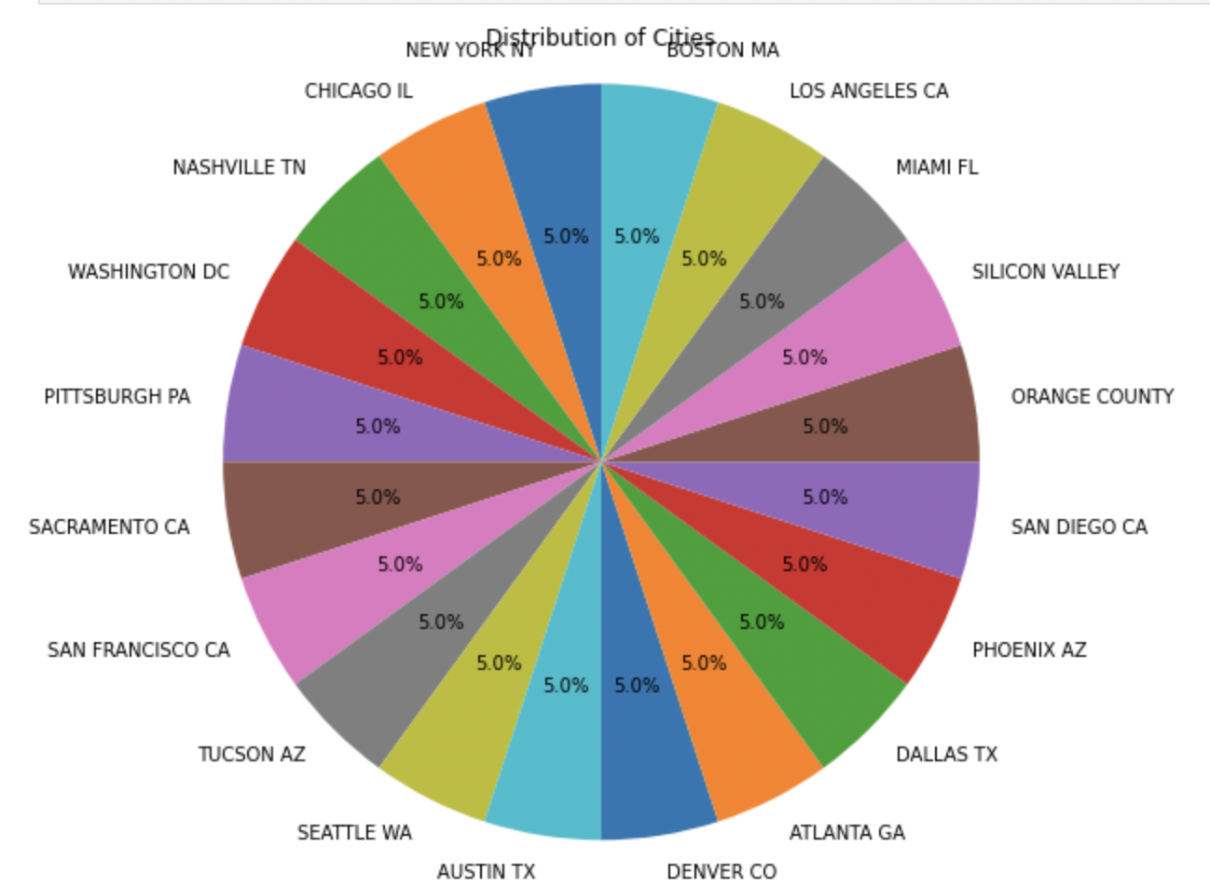
Profit Analysis
reading of datasets
Distribution of cities

Slide 7
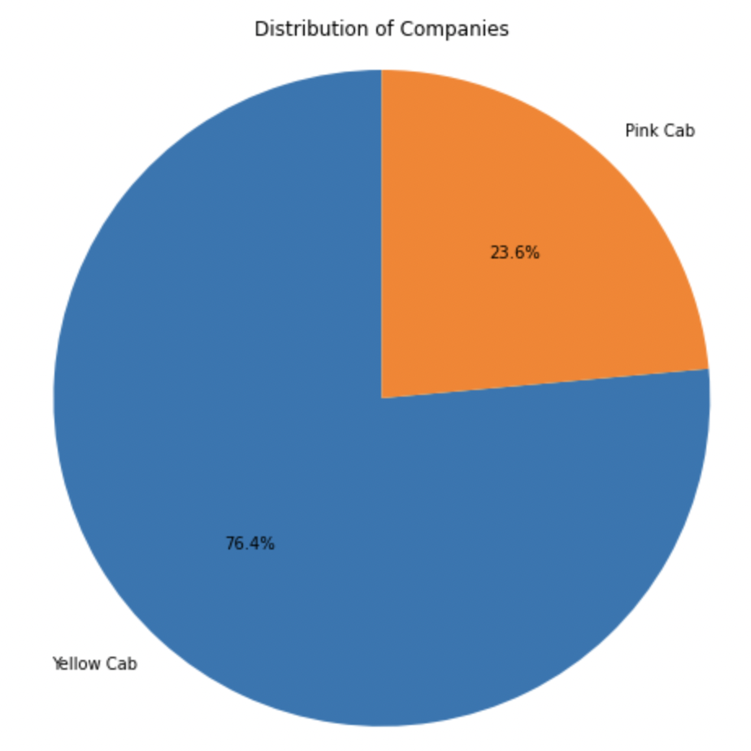
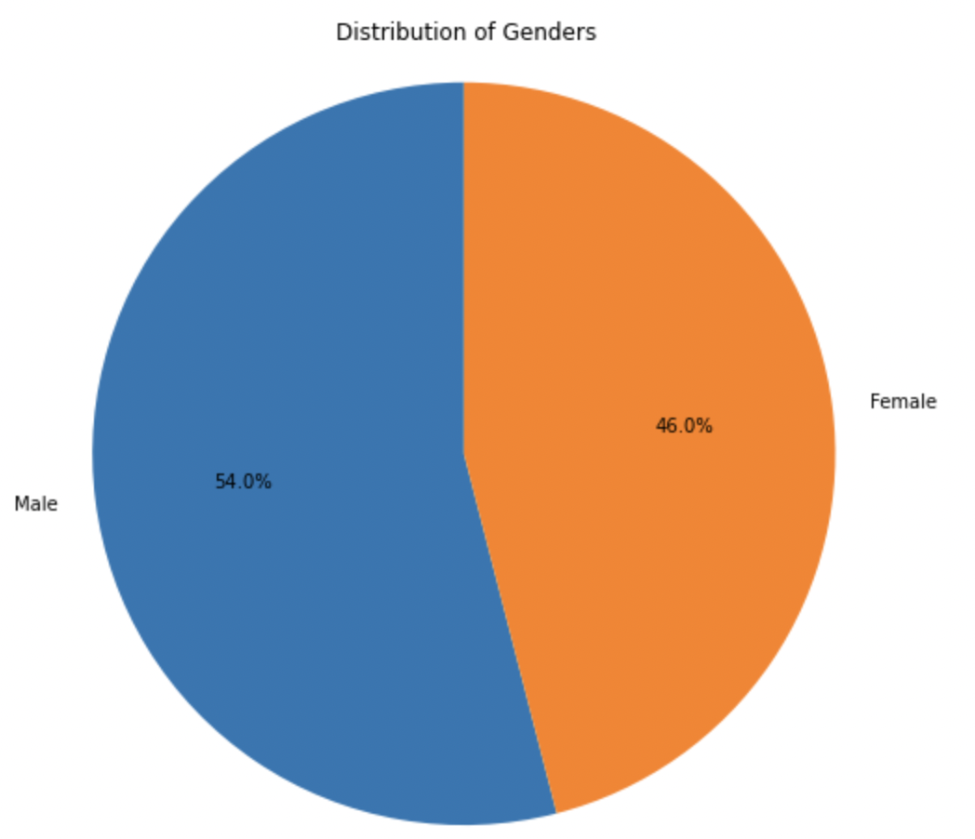
Distribution of companies
Distribution of Genders

Slide 8
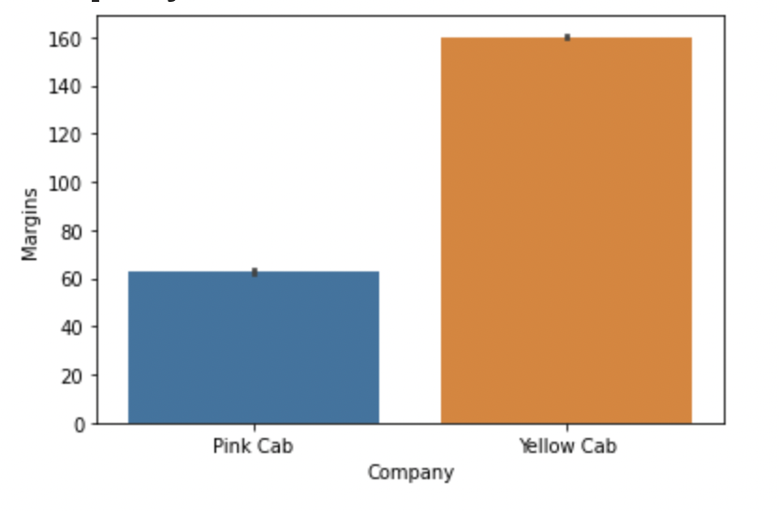
EDA
Based on the bar plot analysis, it is evident that the Yellow Cab company outperforms the Pink Cab company in terms of profit margins. The visualization clearly illustrates the significant difference in profitability between the two companies, with the Yellow Cab company exhibiting higher profit margins.
Profit margins:
This observation holds crucial implications for decision-making processes and investment strategies within the cab industry. The visualization serves as a valuable tool for stakeholders, enabling them to make informed business decisions and potentially explore opportunities for maximizing profitability by aligning with the Yellow Cab company.

Slide 9
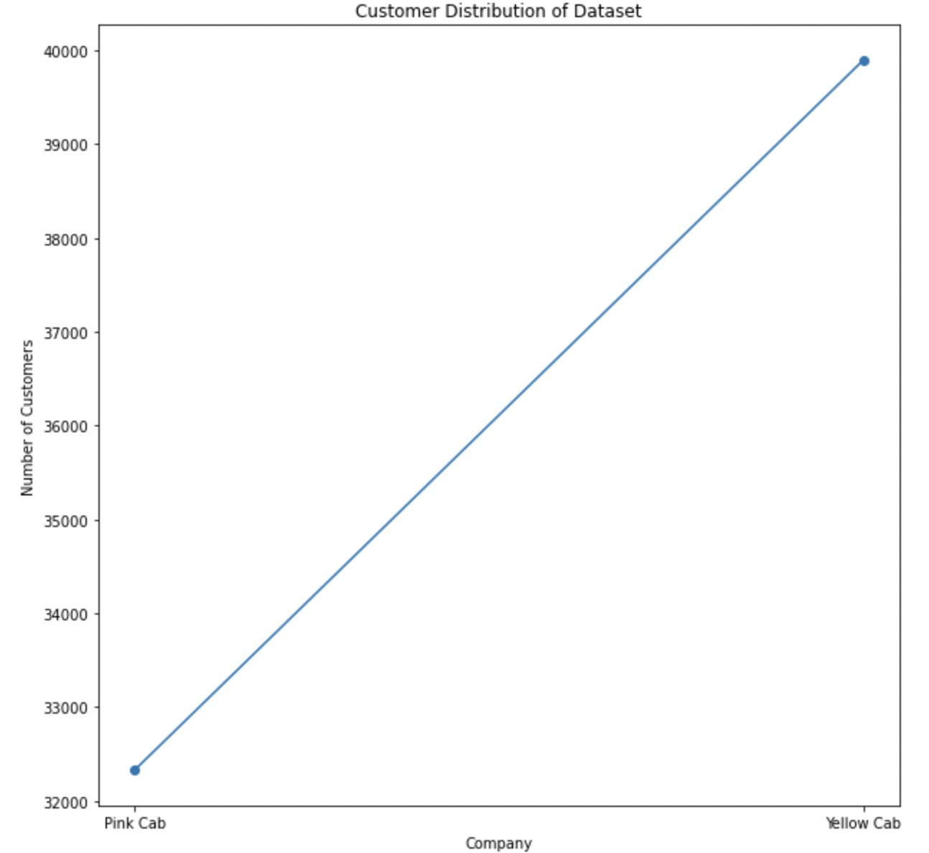
Customer distribution
Yellow cab tends to have more number of customers than the pink cab.
The data underscores the significance of customer acquisition and retention strategies implemented by the Yellow Cab company, enabling them to effectively capture a larger market share and maintain a competitive edge over their counterparts, including the Pink Cab company.
This information holds considerable importance for industry stakeholders and decision-makers, as it provides valuable insights into consumer preferences and the dynamics of the cab industry, facilitating strategic planning and potential growth opportunities.

Slide 10
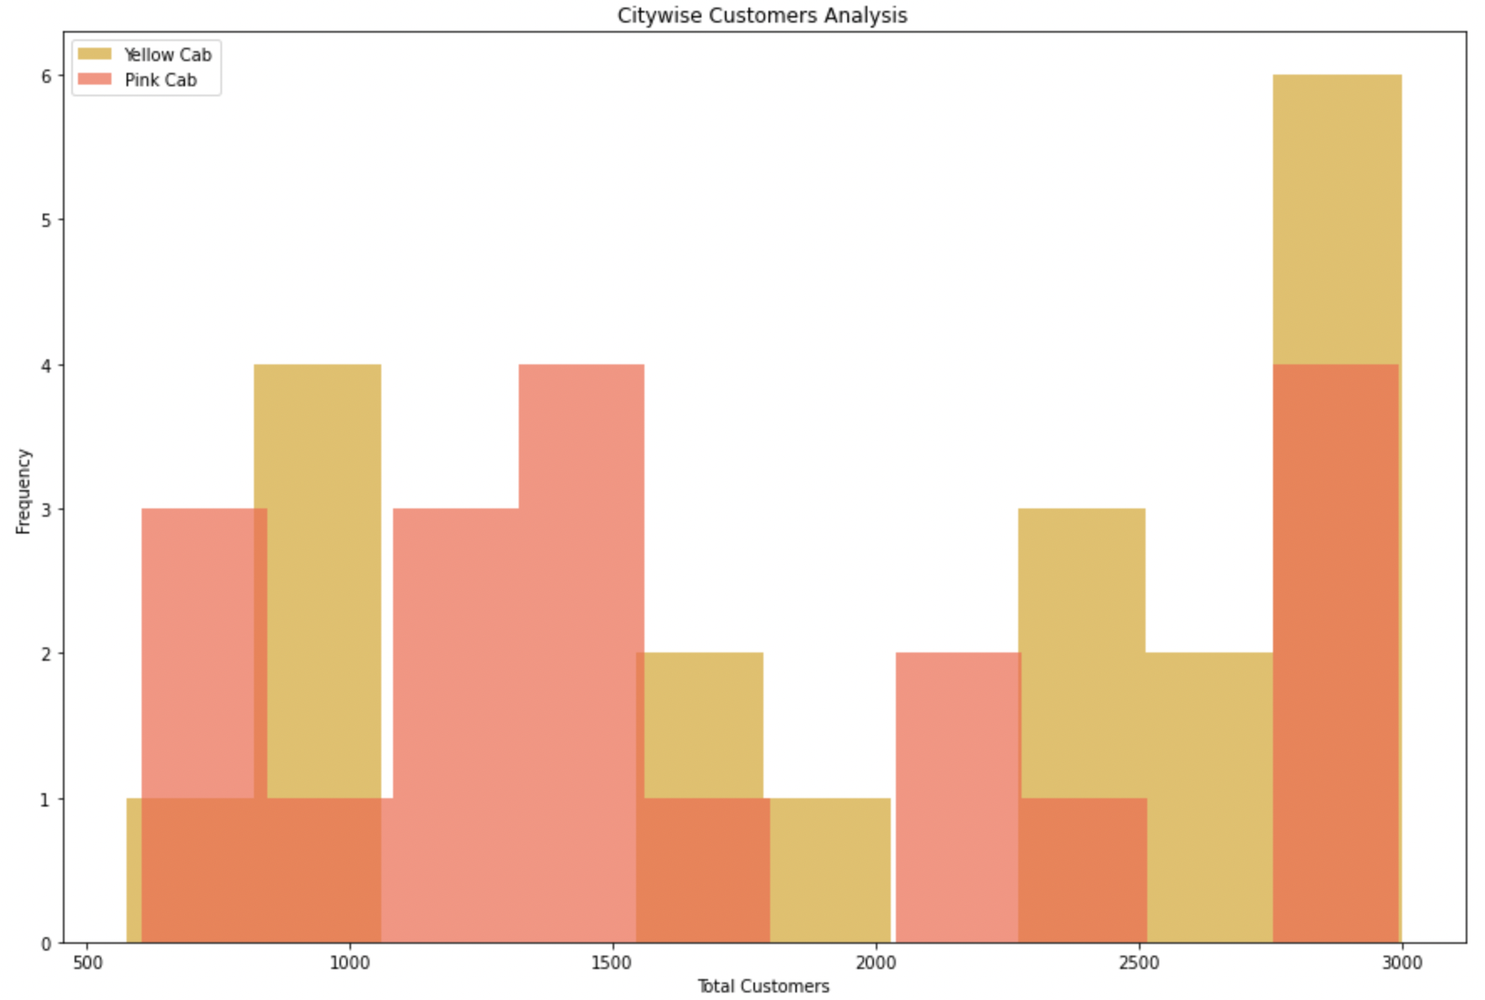
City wise customer analysis
Yellow Cab shows a higher frequency of total customers compared to Pink Cab in some cities.
However, in other cities, Pink Cab has a higher customer frequency compared to Yellow Cab.
Upon a comprehensive analysis of customer data, a notable trend emerges, indicating that the Yellow Cab company exhibits a higher frequency of total customers in certain cities. This observation showcases the Yellow Cab's strong market presence and customer appeal within these specific locations. It suggests that the Yellow Cab has successfully established itself as a preferred choice among customers, leading to a larger customer base in these particular cities.
On the other hand, it is intriguing to note that the Pink Cab company demonstrates a higher customer frequency compared to the Yellow Cab in other cities.

Slide 11
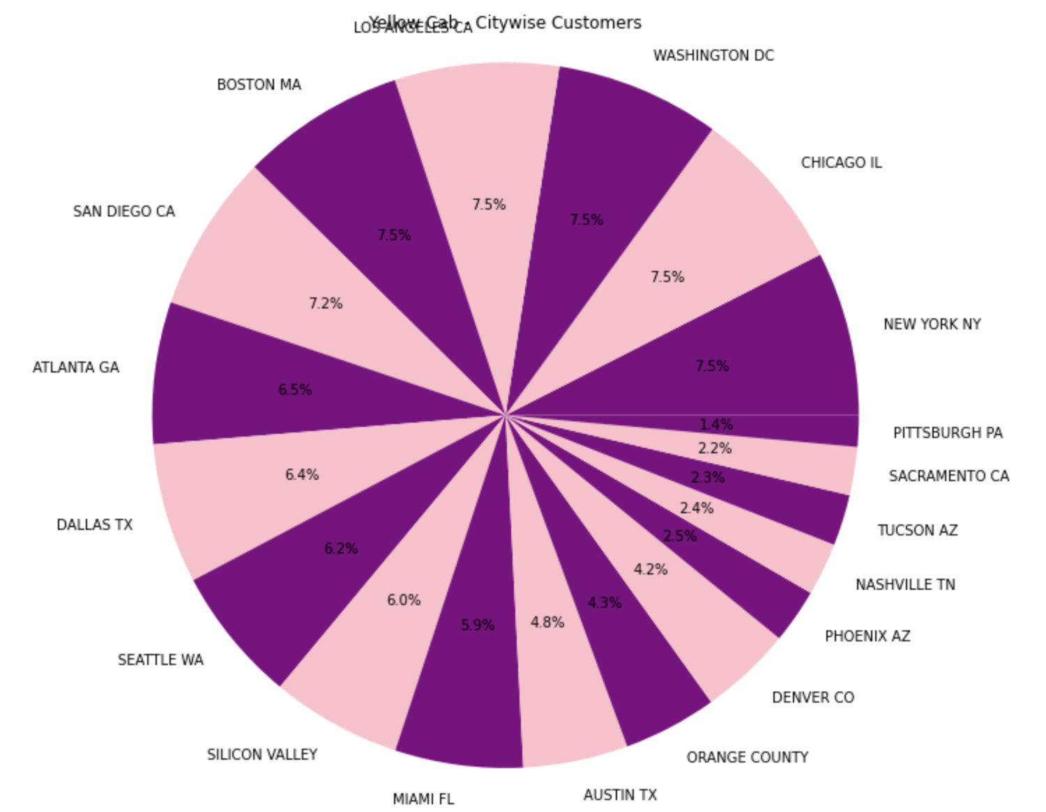
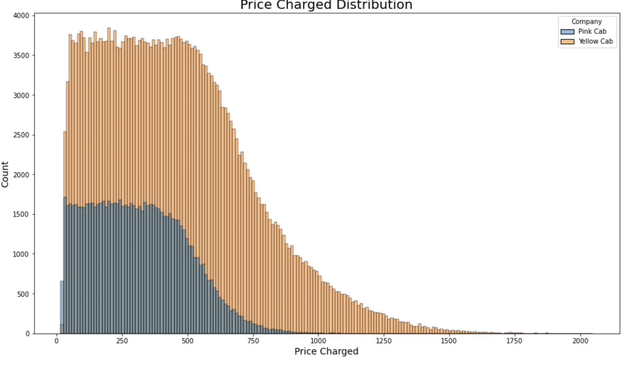
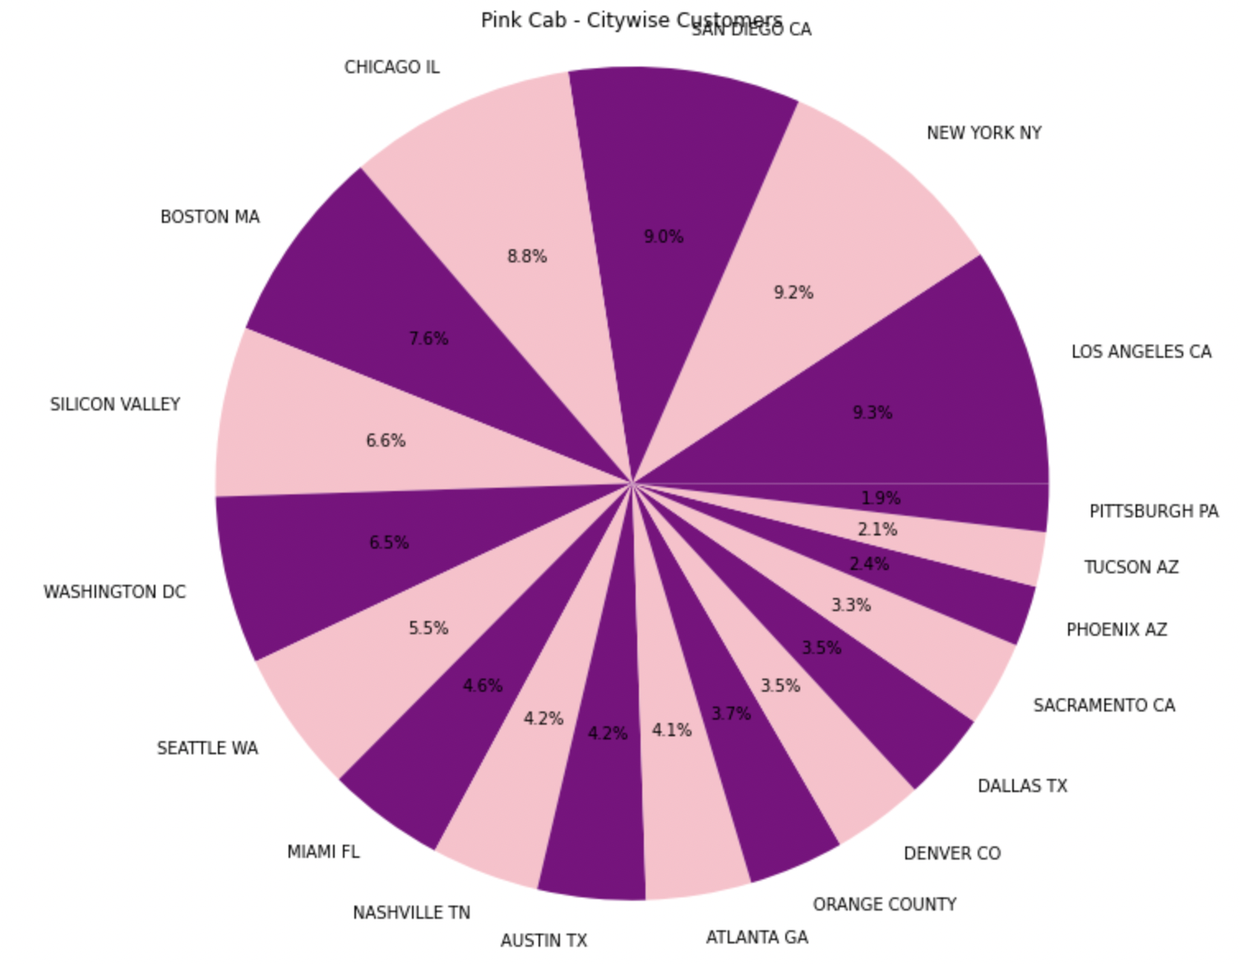
price charged with respect to distance
The price charged distribution of yellow cab (yellow color) is much more comparatively to pink cab (blue color) . The price charged distribution analysis reveals that the Yellow Cab charges higher prices compared to the Pink Cab. This disparity in pricing strategies reflects the different market positioning and customer perceptions of value between the two companies.

Slide 12
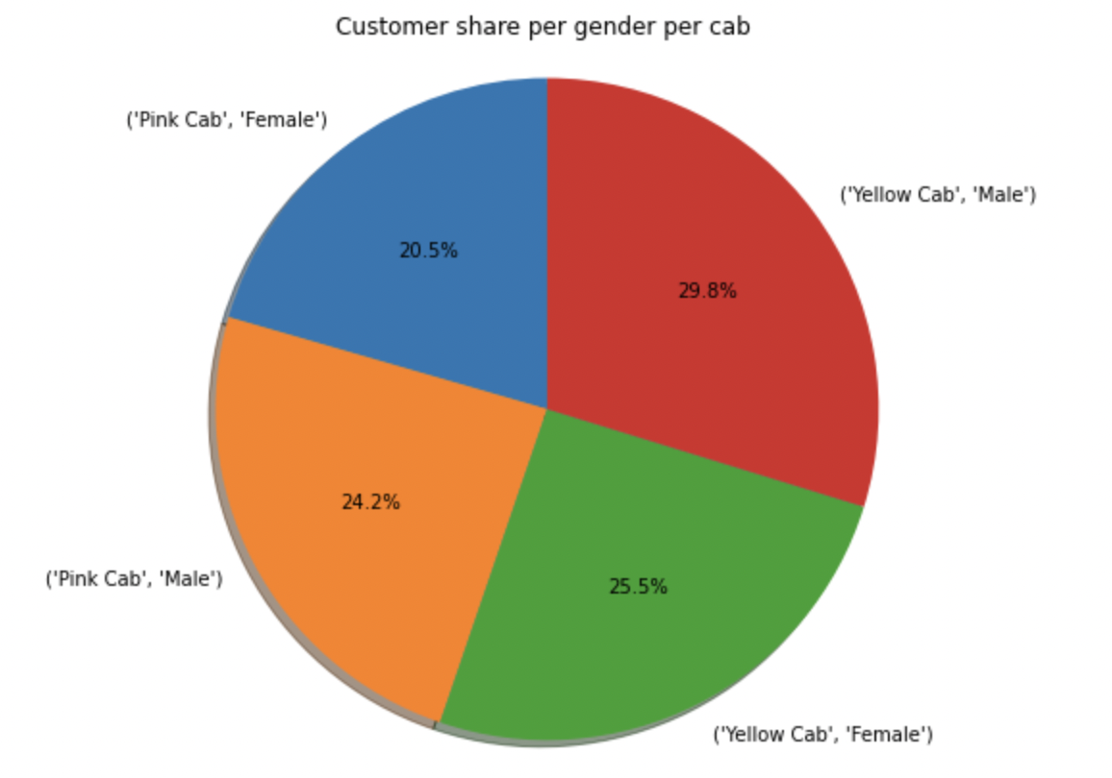
number of unique customers for each combination of company and gender
A thorough analysis of customer data indicates that the Yellow Cab service is consistently favoured by both male and female passengers.
This finding highlights the broad appeal and popularity of the Yellow Cab brand among diverse demographic segments. The data reveals a significant trend where customers, regardless of gender, tend to choose the Yellow Cab as their preferred mode of transportation.

Slide 13
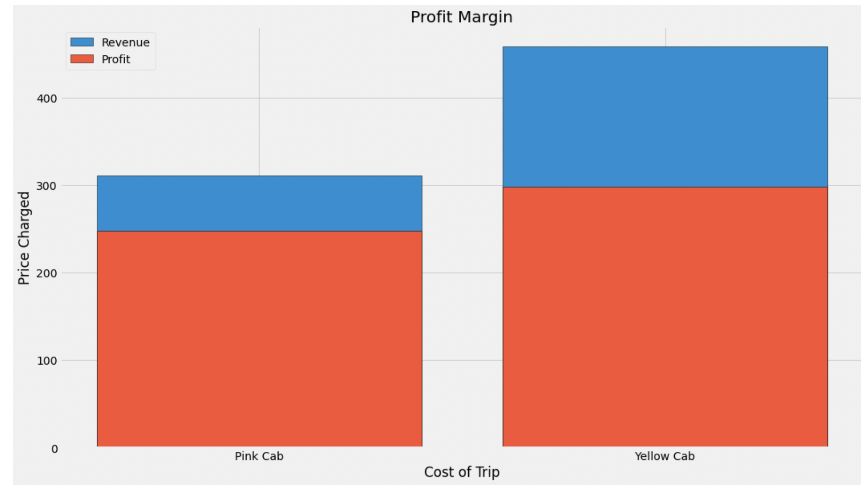
An insightful analysis of the profit (cost of trip) and
revenue (price charged) bars reveals valuable information about the profitability and financial performance of specific companies. When the profit bar consistently surpasses the revenue bar for a particular company, it indicates that the profit margin is relatively lower compared to another company.
Specifically, in the case of the Pink Cab company, this disparity between the profit and revenue bars is noticeably higher, indicating a significantly lower profit margin. This finding highlights a potential concern regarding the financial viability and profitability of the Pink Cab company. The substantial difference between the profit and revenue bars suggests that the costs associated with operating the Pink Cab service are relatively higher compared to the revenue generated from the fares charged.
.
the average price charged and cost of trip for each company

Slide 14
Hypothesis Testing:
Hypothesis 1
Hypothesis: Is there a significant difference in profit based on gender between the two cab companies?
Null Hypothesis (H0): There is no significant difference in profit based on gender between the two cab companies.
Alternate Hypothesis (H1): There is a significant difference in profit based on gender between the two cab companies.
Yellow cab: We accept the alternate hypothesis that there is a statistical difference P value is 6.053552471711072e-25
Pink cab: We accept the null hypothesis that there is no difference P value is 0.11412653488446957

Slide 15
Hypothesis 2
Hypothesis: There is no seasonality in the number of customers using the cab service.
Null Hypothesis (H0): There is no seasonality in the number of customers using the cab service.
Alternate Hypothesis (H1): There is seasonality in the number of customers using the cab service.
We accept the null hypothesis that there is no seasonality

Slide 16
Hypothesis 3
Hypothesis: There is no significant difference in the number of customers between different cab companies at different time periods.
Null Hypothesis (H0): There is no significant difference in the number of customers between different cab companies at different time periods.
Alternate Hypothesis (H1): There is a significant difference in the number of customers between different cab companies at different time periods.
We accept the null hypothesis that there is no significant difference

Slide 17
Hypothesis 4
Hypothesis: There is a significant relationship between the number of customers and the profit margin in the cab service.
Null Hypothesis (H0): There is no significant relationship between the number of customers and the profit margin in the cab service.
Alternate Hypothesis (H1): There is a significant relationship between the number of customers and the profit margin in the cab service.
We fail to reject the null hypothesis. There is no significant relationship between the number of customers and profit margin.

Slide 18
Hypothesis 5
Hypothesis: There is no significant difference in the number of customers between different cab companies at different time periods.
Null Hypothesis (H0): There is no significant difference in the number of customers between different cab companies at different time periods.
Alternate Hypothesis (H1): There is a significant difference in the number of customers between different cab companies at different time periods.
We accept the null hypothesis that there is no significant difference in the distribution of income for different segments.

Slide 19
Conclusion:
Based on a comprehensive analysis of various factors, the Yellow Cab company emerges as the recommended choice over the Pink Cab company. In a majority of cases, the Yellow Cab company demonstrates a distinct advantage and superiority compared to the Pink Cab company.
The extensive evaluation of key metrics, including customer preferences, market share, profitability, and overall performance, consistently points to the Yellow Cab company as the preferred option. The Yellow Cab's strong market presence, higher customer base, and wider popularity contribute to its competitive edge and potential for sustained success.
By surpassing the Pink Cab in multiple areas, the Yellow Cab demonstrates its ability to meet and exceed customer expectations, deliver a superior service experience, and maintain a favourable market position. This recommendation is reinforced by the data-driven insights and analysis, which highlight the Yellow Cab's favourable performance metrics and industry reputation.
Considering the overall assessment and analysis, stakeholders, customers, and potential investors are advised to prioritize the Yellow Cab company due to its proven advantages and superior performance over the Pink Cab company. By aligning with the Yellow Cab, stakeholders can maximize their chances of success and benefit from the company's strong market position, customer loyalty, and profitability.

Slide 20
Thank You

